Slide 1

实证资产定价:Liquidity
张欣然
中央财经大学金融学院
邮箱：zhangxinran@cufe.edu.cn

Slide 2
本节授课内容
Amihud 2002 JFM
流动性指标复制编程代码
推荐阅读：流动性后续研究
  流动性的后续研究
  流动性在中国

Slide 3
流动性 Liquidity
Amihud 2002
非流动性（Illiquidity）高的股票未来收益率高

Slide 4
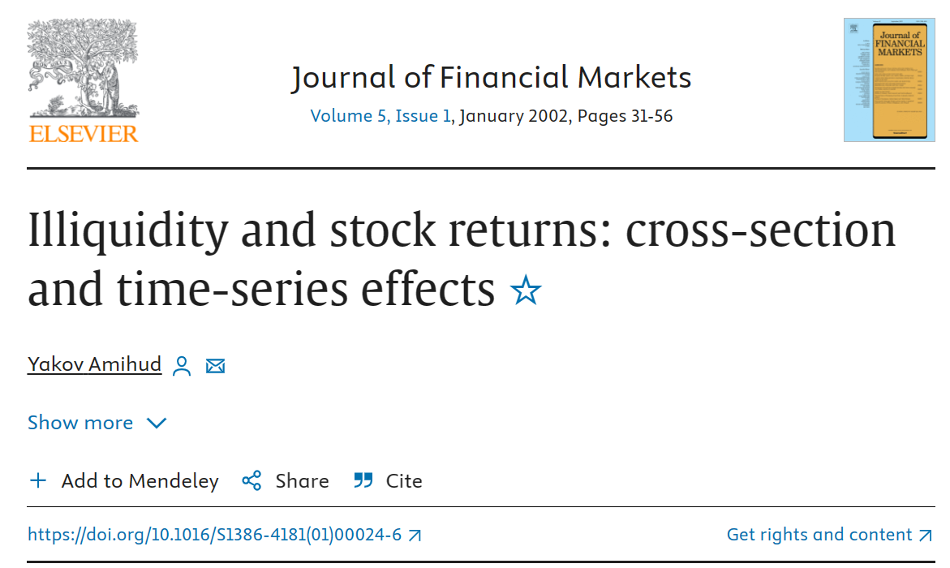
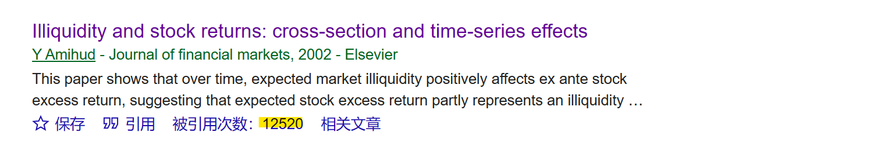
论文信息

Slide 5
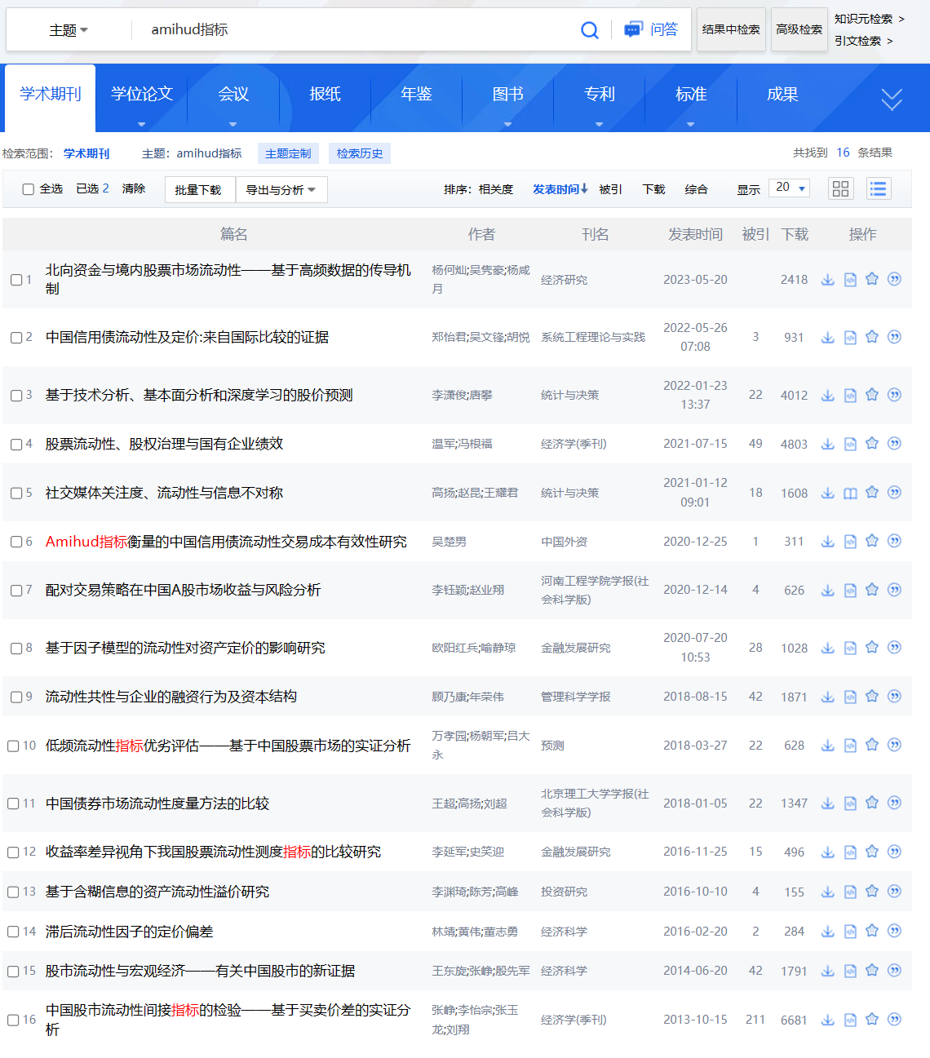


Slide 6
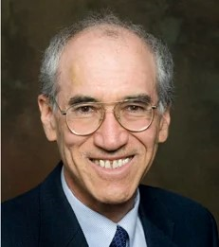
Yakov Amihud
工作职位：
Leonard N. Stern School of Business, NYU
Ira Rennert Professor of Entrepreneurial Finance
教育背景：
1975 Doctor of Philosophy in Business Administration, New York University
1973 Master of Science in Business Administration, New York University
1969 Bachelor of Social Science, Hebrew University, Jerusalem, Israel
Notes:
https://www.stern.nyu.edu/faculty/bio/yakov-amihud

Slide 7
Yakov Amihud
研究范围：Evaluation of corporate financial policies, mergers and acquisitions, initial public offerings, objectives of corporate managers, dividend policy, and law and finance
研究专长：The effects of liquidity of assets on their returns and values, and the design and evaluation of securities markets' trading methods. On these topics, Amihud has done consulting work for the NYSE, AMEX, CBOE, CBOT, and other securities markets.

Slide 8
Liquidity
Liquidity is an elusive concept
Illiquidity: the impact of order flow on price, the discount that a seller concedes or the premium that a buyer pays when executing a market order.
Price impact: Larger excess demand induces a greater impact on prices, reflecting a likely action of informed traders. (Easley and O’Hara, 1987)

Slide 9
Liquidity
Kyle (1985) because market makers cannot distinguish between order flow that is generated by informed traders and by liquidity (noise) traders, they set prices that are an increasing function of the imbalance in the order flow that indicate informed trading.
A positive relationship between the order flow and price change, commonly called the price impact.

Slide 10
Liquidity
Previous illiquidity measures
  Quoted spread
  Effective spread
  Price impact
  PIN
  …

Slide 11
Amihud 2002
Amihud and Mendelson 1986: positive return-illiquidity relationship (cross-section)
Amihud 2002 examines over time:
  Over time, the ex ante stock excess return is increasing in the expected illiquidity of the stock market.

Slide 12
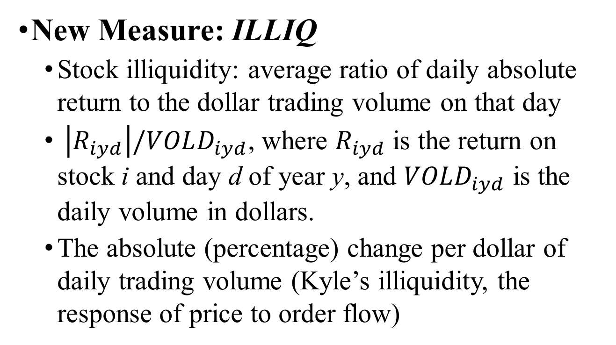
Amihud 2002
New Measure: ILLIQ
  Stock illiquidity: average ratio of daily absolute return to the dollar trading volume on that day
  $\left|R_{iyd}\right|/VOLD_{iyd}$, where $R_{iyd}$ is the return on stock i and day d of year y, and $VOLD_{iyd}$ is the daily volume in dollars.
  The absolute (percentage) change per dollar of daily trading volume (Kyle’s illiquidity, the response of price to order flow)

Slide 13
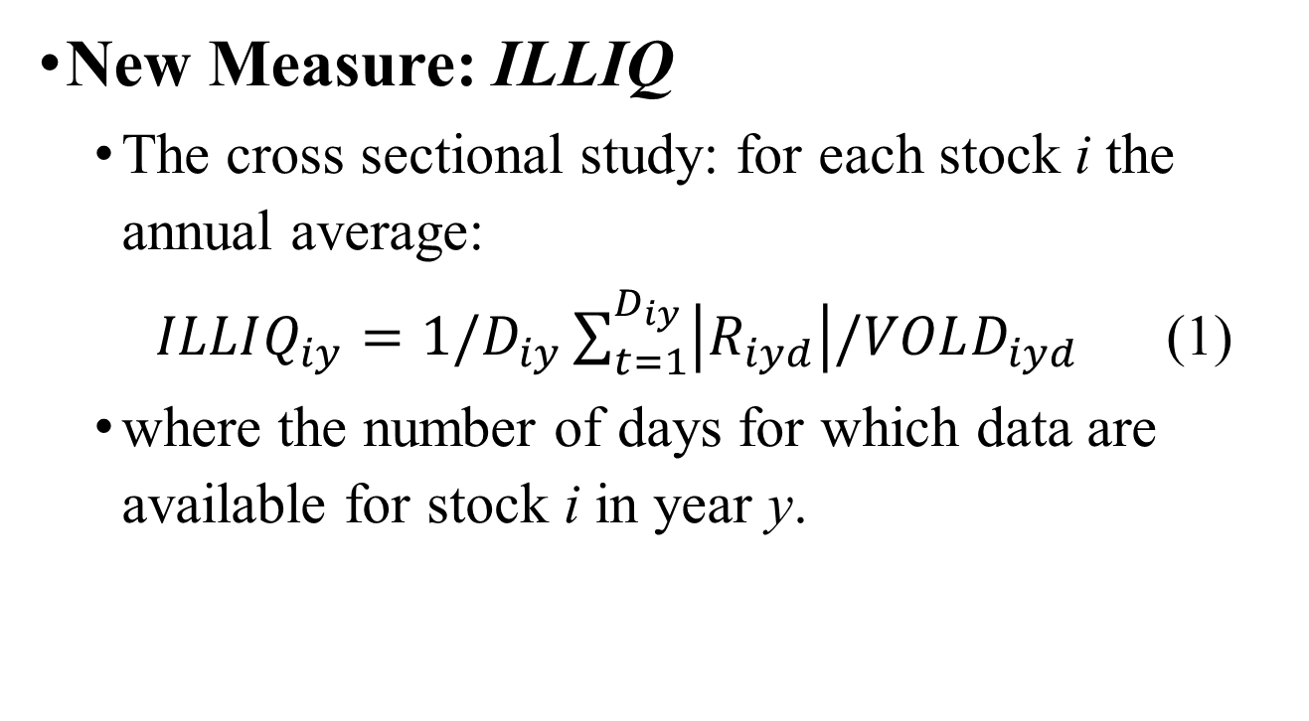
Amihud 2002
New Measure: ILLIQ
  The cross sectional study: for each stock i the annual average:
  $ILLIQ_{iy}=1/D_{iy}\sum_{t=1}^{D_{iy}}{\left|R_{iyd}\right|/VOLD_{iyd}}$ (1)
  where the number of days for which data are available for stock i in year y.

Slide 14
Amihud 2002
Why new measure?
  There are finer and better measures of illiquidity, such as bid ask spread (quoted or effective), transaction-by-transaction market impact or the probability of information-based trading (PIN)
  These measures require a lot of microstructure data that are not available in many stock markets.

Slide 15
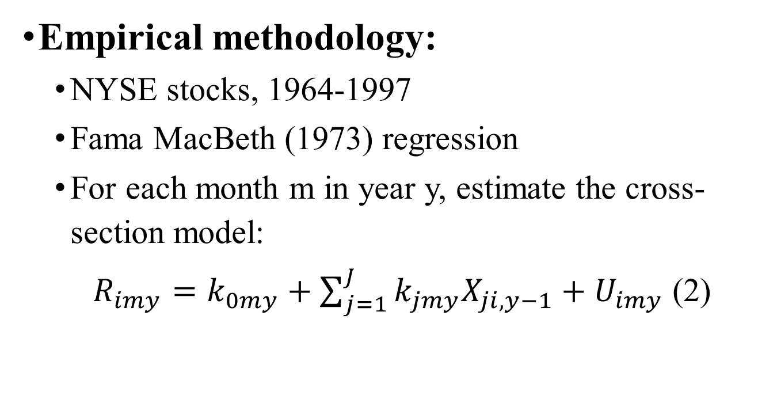
Amihud 2002
Empirical methodology:
  NYSE stocks, 1964-1997
  Fama MacBeth (1973) regression
  For each month m in year y, estimate the cross-section model:
  $R_{imy}=k_{0my}+\sum_{j=1}^{J}{k_{jmy}X_{ji,y−1}}+U_{imy}$ (2)

Slide 16
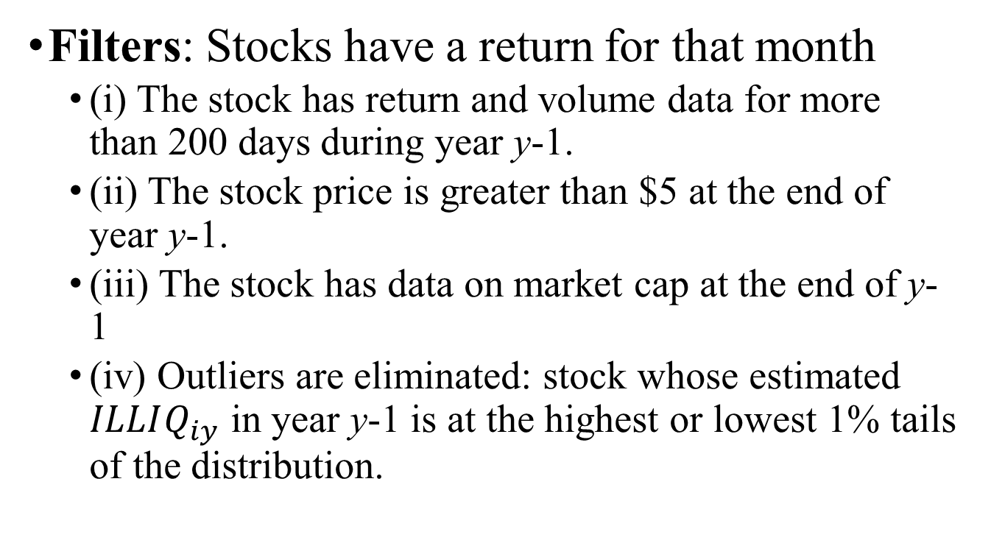
Amihud 2002
Filters: Stocks have a return for that month
  (i) The stock has return and volume data for more than 200 days during year y-1.
  (ii) The stock price is greater than $5 at the end of year y-1.
  (iii) The stock has data on market cap at the end of y-1
  (iv) Outliers are eliminated: stock whose estimated $ILLIQ_{iy}$ in year y-1 is at the highest or lowest 1% tails of the distribution.

Slide 17
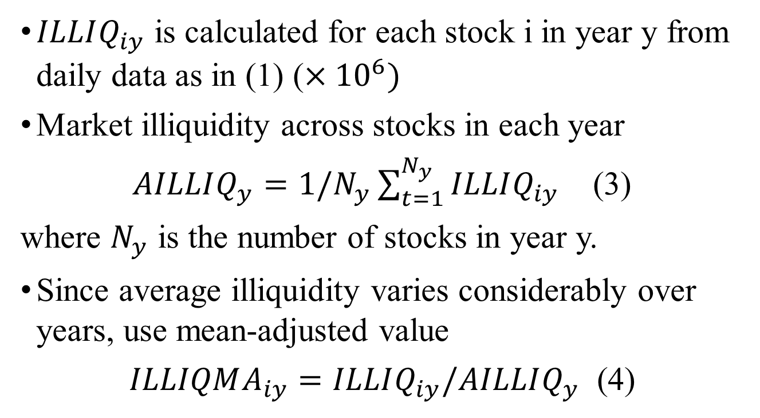
Amihud 2002
$ILLIQ_{iy}$ is calculated for each stock i in year y from daily data as in (1) ($×{10}^{6})$
Market illiquidity across stocks in each year
$AILLIQ_{y}=1/N_{y}\sum_{t=1}^{N_{y}}{ILLIQ_{iy}}$ (3)
where $N_{y}$ is the number of stocks in year y.
Since average illiquidity varies considerably over years, use mean-adjusted value
$ILLIQMA_{iy}=ILLIQ_{iy}/AILLIQ_{y}$ (4)

Slide 18
Amihud 2002
Finding 1:
ILLIQ has positive effect on expected return across stocks

Slide 19
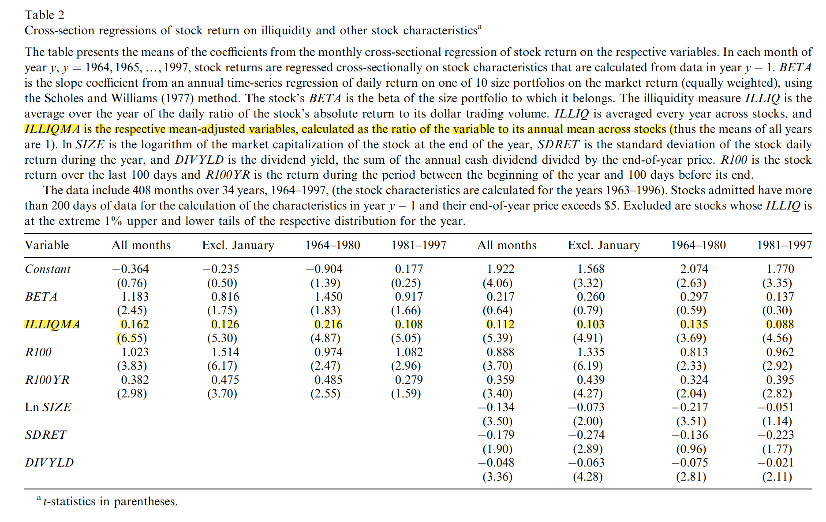

Slide 20
Let’s do it!
Download the data and paly it in SAS.
The coefficient of ILLIQMA is positive.

Slide 21
Amihud 2002
Finding 2: ILLIQ has positive effect on expected return over time
Two hypotheses:
(1) ex ante stock excess return is an increasing function of expected illiquidity
(2) unexpected illiquidity has a negative effect on contemporaneous unexpected stock return.

Slide 22
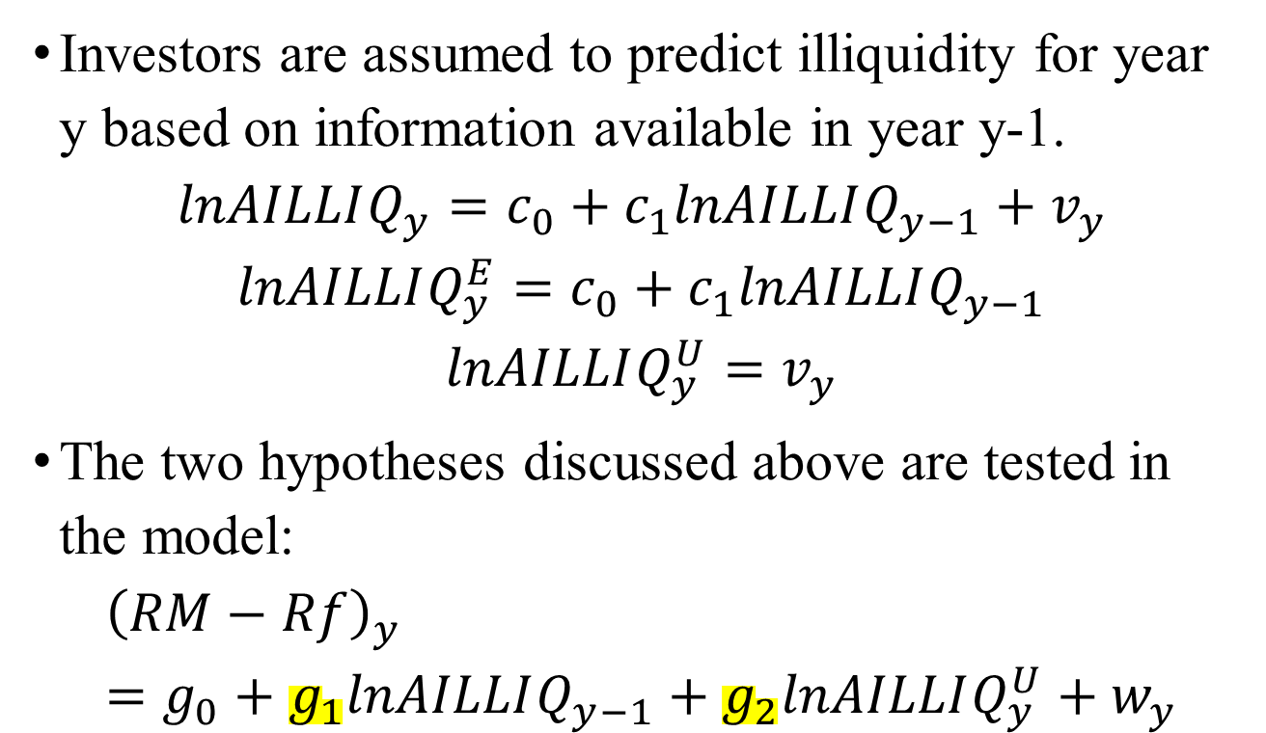
Amihud 2002
Investors are assumed to predict illiquidity for year y based on information available in year y-1.
$$lnAILLIQ_{y}=c_{0}+c_{1}lnAILLIQ_{y−1}+v_{y}$$
$$lnAILLIQ_{y}^{E}=c_{0}+c_{1}lnAILLIQ_{y−1}$$
$$lnAILLIQ_{y}^{U}=v_{y}$$
The two hypotheses discussed above are tested in the model:
$${\left(RM−Rf\right)}_{y}=g_{0}+g_{1}lnAILLIQ_{y−1}+g_{2}lnAILLIQ_{y}^{U}+w_{y}$$

Slide 23
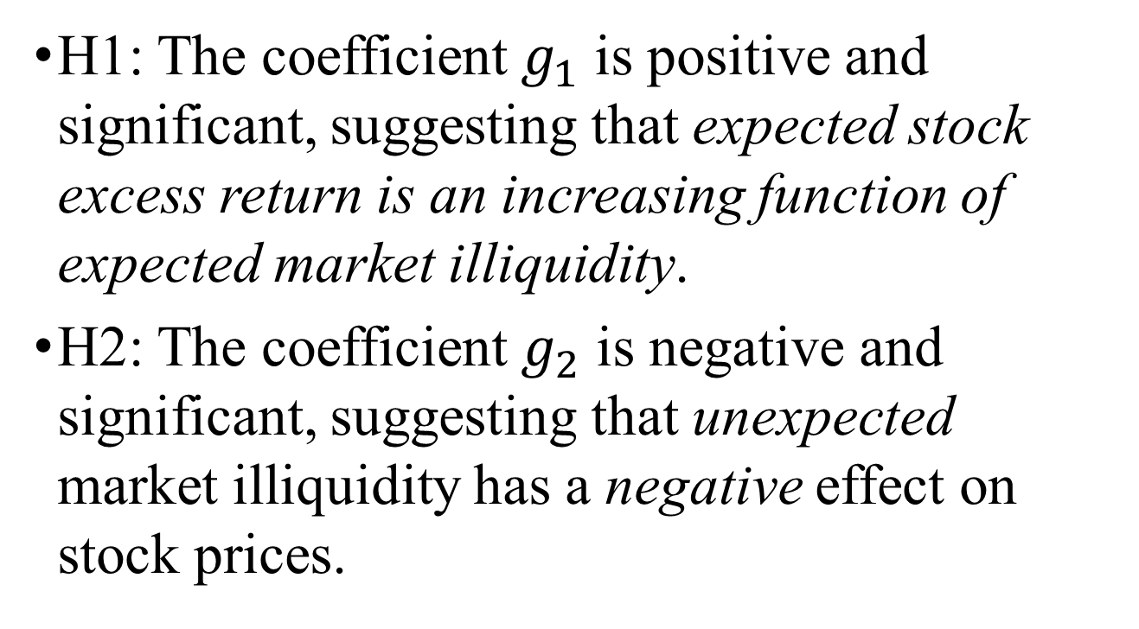
Amihud 2002
H1: The coefficient $g_{1}$ is positive and significant, suggesting that expected stock excess return is an increasing function of expected market illiquidity.
H2: The coefficient $g_{2}$ is negative and significant, suggesting that unexpected market illiquidity has a negative effect on stock prices.

Slide 24
Amihud 2002
Finding 2:
  Over time, expected market illiquidity positively affects expected stock excess return (the stock return in excess of Treasury bill rate).
  If investors anticipate higher market illiquidity, they will price stocks so that they generate higher expected return.
  Stock excess return, traditionally interpreted as “risk premium”, includes a premium for illiquidity.

Slide 25
Amihud 2002
Finding 3:
Unexpected market illiquidity lowers contemporaneous stock prices
  Higher realized illiquidity raises expected illiquidity, that in turn raises stock expected returns and lowers stock prices.
These illiquidity effects are shown to be stronger for small firms’ stocks
  “size effect”: the excess return on small firms’ stocks are related to changes in market liquidity over time.

Slide 26
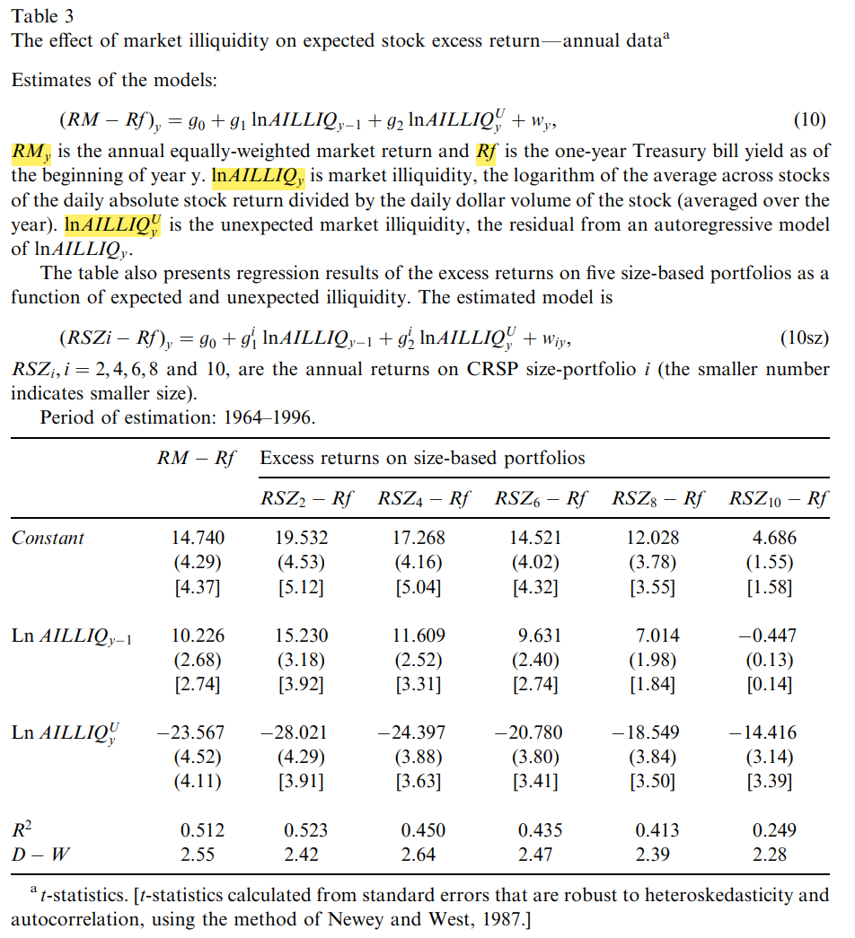

Slide 27
延伸阅读
Amihud and Noh (2021 RFS) Illiquidity and stock returns II: cross-section and time-series effects
杨何灿等（2023 经济研究）北向资金与境内股票市场流动性——基于高频数据的传导机制

